Slide 1
Examples of Mathematical Programs
(JSS30 Exercises Day01a)

Slide 2


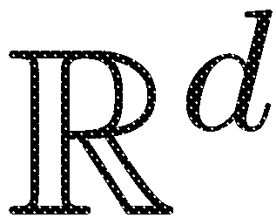

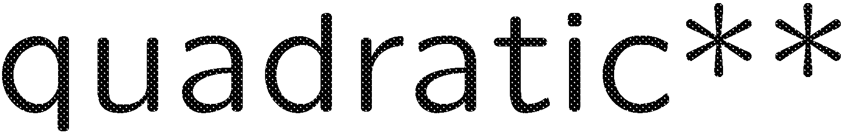

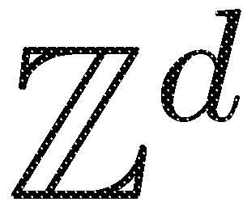



Classification: Mathematical Programming
*A QP is also an NLP; A ILP is also a IP.
For the comprehensive authorative classification of INFORMS by Dantzig, see: http://glossary.computing.society.informs.org/index.php?page=nature.html

Slide 3
Multiobjective Mathematical Program
multiobjective optimization

Slide 4

Example 1: Mathematical Program for Reactor
Chemical Reactor
Profit to be maximized, while temperature and waste must not exceed certain thresholds.
How to formulate this as a mathematical program?
Decision variables: Concentrations of educts:
Mathematical Program:
subject to
Profit(x1,x2)
Chemical
Reactor Model
x1
Waste(x1,x2)
Temperature(x1,x2)
x2

Slide 5
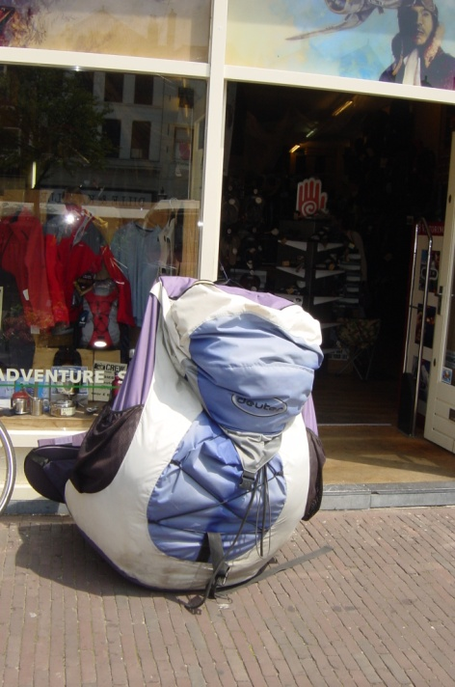
Example 2: Constrained 0/1 Knapsack Problem
The total value of the items in the knapsack (in [$]) should be maximized, while its total weight (in [kg]) should not exceed
MAXWEIGHT. Here v_{i} is the value of item i in [$] and w_{i} is its weight in [kg]. i=1, …, d are indices of the items.
Picture: © Michael Emmerich (instructor)
What is the role of the binary variables here?
What type of mathematical programming problem is this?
Can this also be formulated as a quadratic programming
problem?

Slide 6
Example: Multiobjective 0/1 Knapsack Problem
The total value of the items in the knapsack (in [$]) should be maximized, while its total weight (in [kg]) should be minimized.

Slide 7
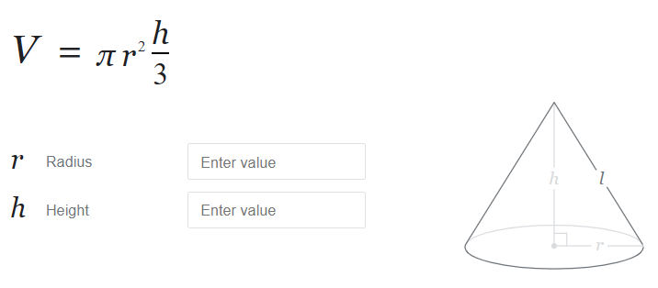

Example: Equality Constraint for Tin Problem
Minimize the area of surface A for a cylinder that contains V = 330 ml sparkling juice!
x₁
330ml
x₂
Inside cone
Problem sketch
Exercise: Formulate the problem for icecream cones as a mathematical programming problem! Surface of waffle to be 100ml Volume maximized (1/2 sphere+cone volume)
Some interesting research question: Find optimal shapes or given constraints on geometry.
For instance: Convex hull of N points with minimal surface and maximal volume.

Slide 8
Example: Knapsack Problem with Cardinality Constraint
The total value of the items in the knapsack (in [$]) should be maximized, while its total weight (in [kg]) should be below MAXN and at most MAXN items can be chosen.

Slide 9
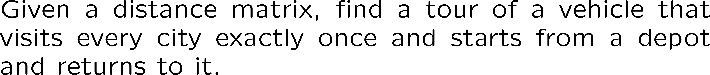
Example: Traveling Salesperson Problem
This can be easily described, but how to model this in terms of discrete (binary) variables and (constraint) functions that depend on them?

Slide 10
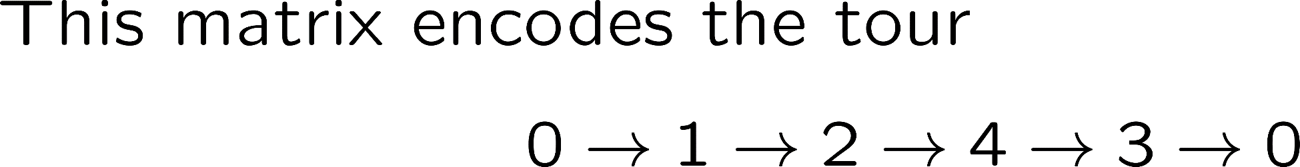
Encoding of a TSP tour
City 1 | City 2 | City 3 | City 4
1 | 0 | 0 | 0
0 | 1 | 0 | 0
0 | 0 | 0 | 1
0 | 0 | 1 | 0

Slide 11
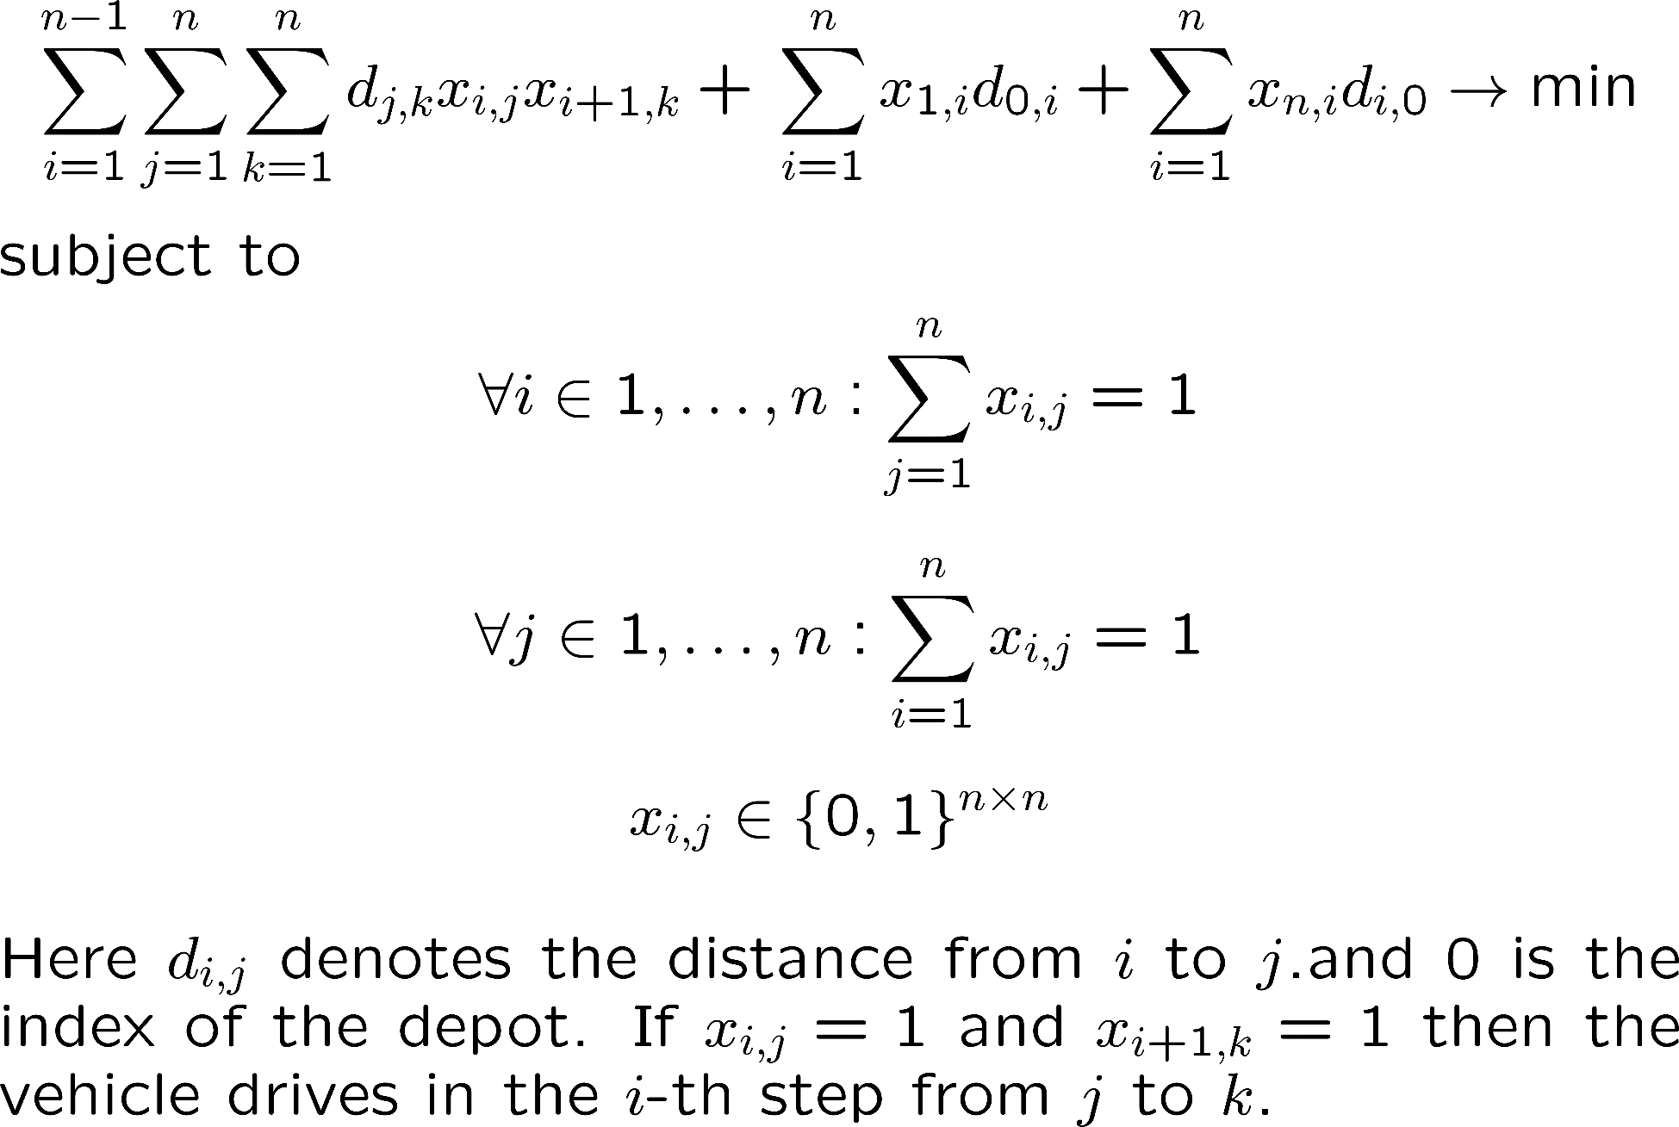
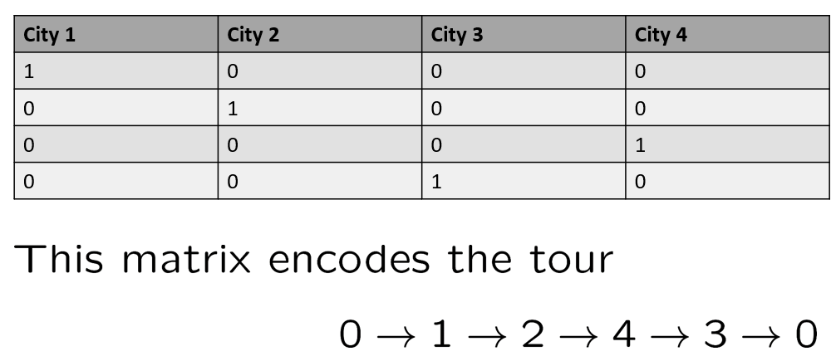

Recall. Previous slide
Exercise: How does this equation change if one is starting at node and the tour needs to end in other depot, say node ?

Slide 12
Mathematical Programming Models: Exercise
Question: How to solve problems of the following kind with an LP solver:
}
where are linear functions of the type
?
Answer: ….
MIN
MAX
Trick
QP
Trick
Let us assume the problem
s.t. , , i
How can we formulate it as a nonlinear problem with continuous variables?
Answer: ….

Slide 13
Mathematical Programming Models
Question: How to solve problems of the following kind with an LP solver:
}
where are linear functions of the type
?
Answer: ….
MIN
MAX
Trick
QP
Trick
Let us assume the problem
s.t. , , i
How can we formulate it as a continuous problem?
Answer: ….

Slide 14
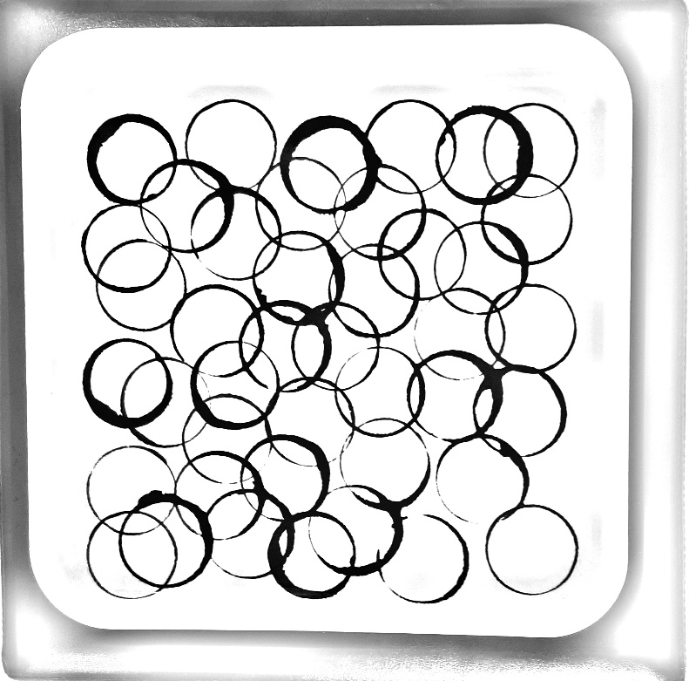
Placement of unit discs on the square – mixed integer problem – ‘Big M trick’
How to formulate the problem of placing as many unit discs of radius 1.5m possible on a square of side length 100meter? The unit discs may not overlap.
Answer:
is upper bound for number of discs that fit.
Only if and = 1, the distance constraint is checked, otherwise it is always satified (inactive discs cannot overlap)
But: Highly non-linear!
Unit disc problem: Infeasible design due to overlap.
Alternative QP formulation (big M trick):
Two tricks are used here:
Big M: choose an M so big that whenever or then is satisfied . What is the minimal value for M?
Omit the square root by taking the square on both sides of Values are always positive.

Slide 15
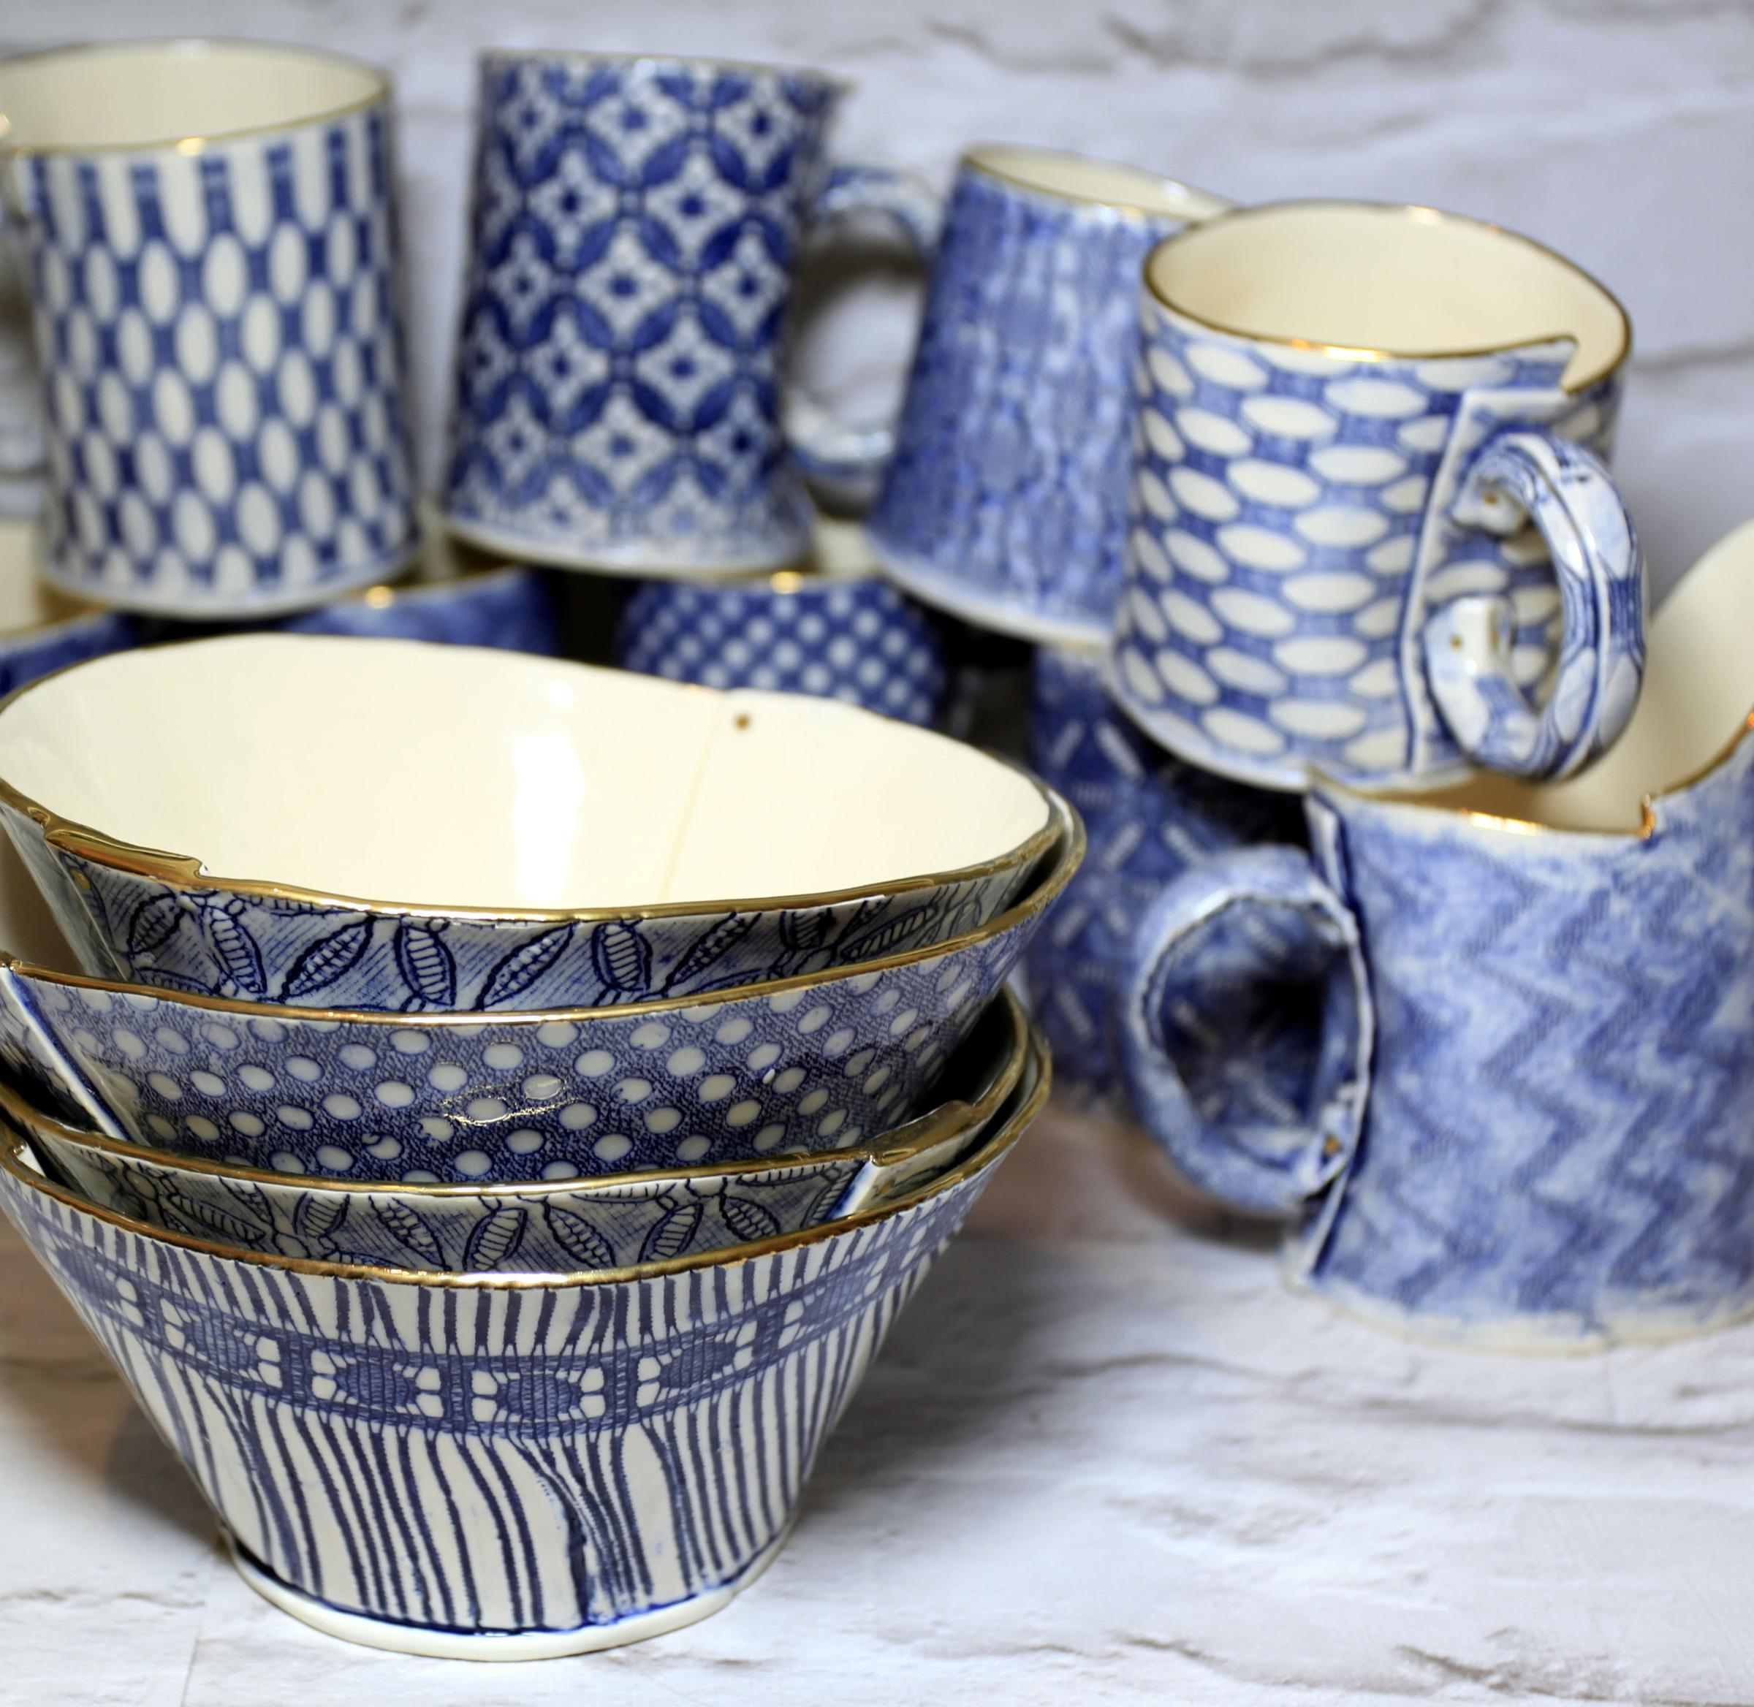
Exercise: Linear Programming
Making Mugs and Bowls
Mr. Asep makes mugs and bowls. It takes 4 minutes to make a mug and 3 minutes to make a bowl. A mug consists of 1kg of clay and a bowl requires 1.5kg. of clay. He has 20 hours available for making the mugs and bowls and has 450 kg. of clay on hand. He makes a profit of $2 on each mug and $3 on each bowl.
How many mugs and how many bowls should he make in order to maximize her profit? Solve graphically and/or with LP Solve.
x = number of produced mugs
y = number of produced bowls
This homework is only for exercise and not graded. The solution
will be discussed in the next lecture.
https://online-optimizer.appspot.com/?model=builtin:default.mod

Slide 16

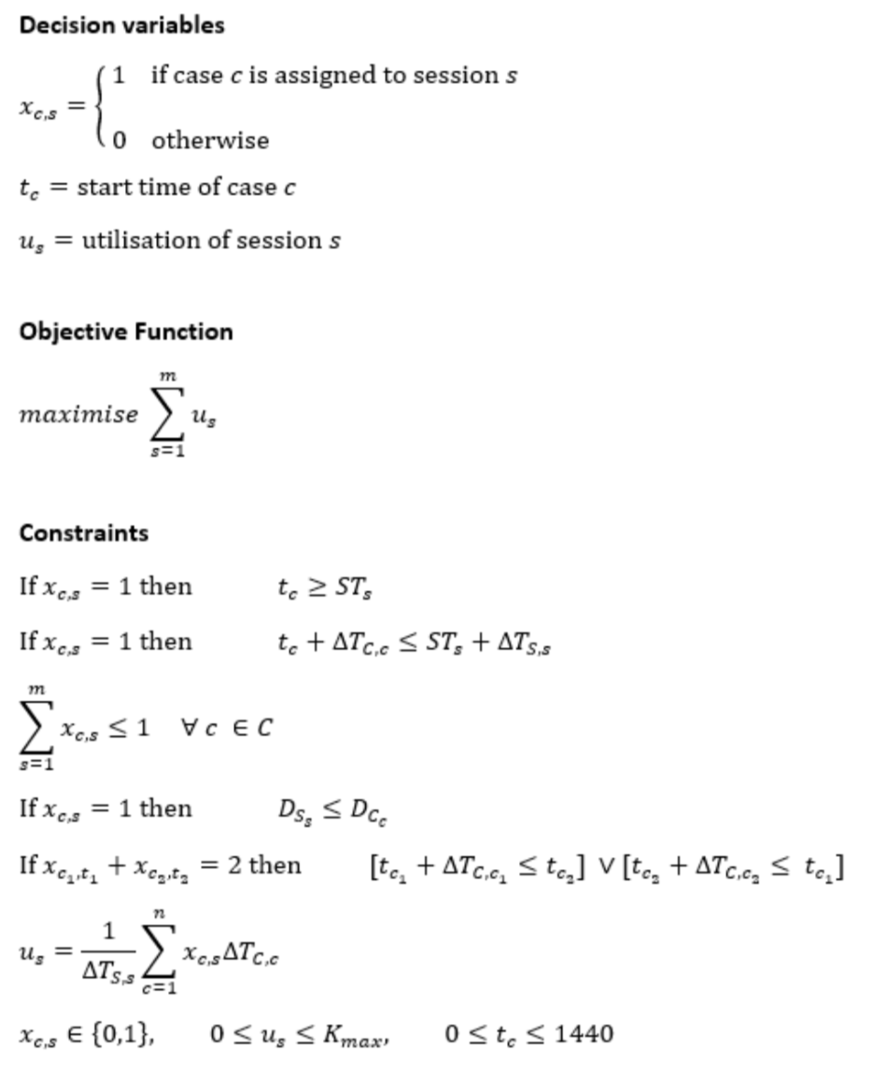
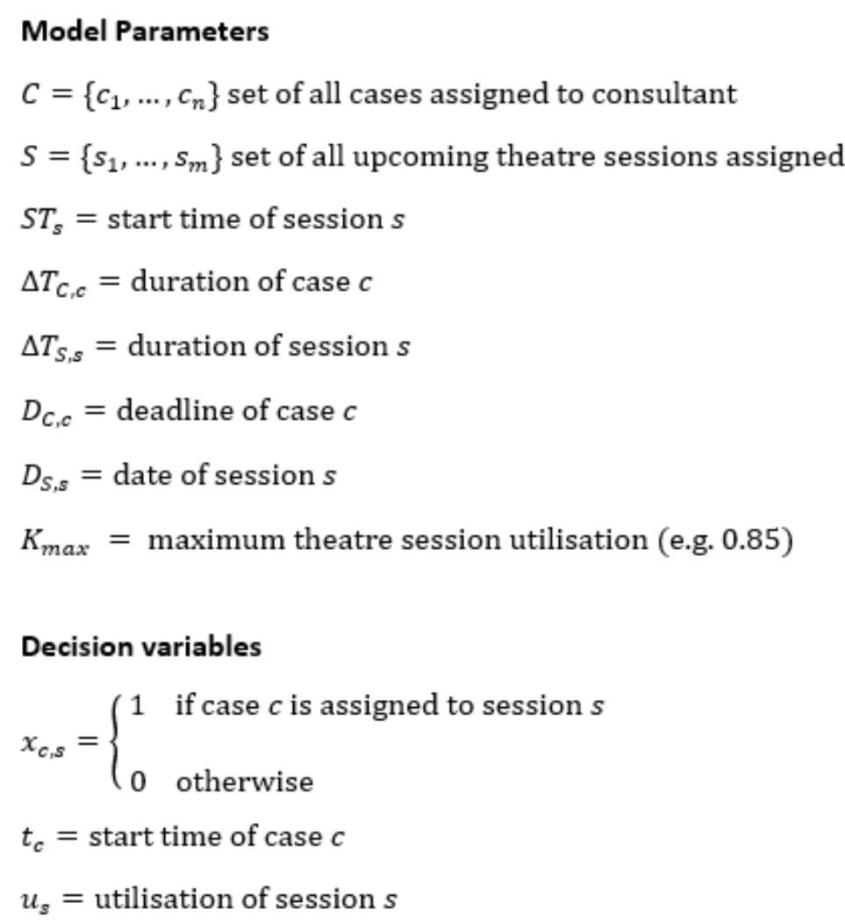

Timetabling example (pyomo)
https://towardsdatascience.com/schedule-optimisation-using-linear-programming-in-python-9b3e1bc241e1

